Slide 1
Image Filtering
Part – 1

Slide 2
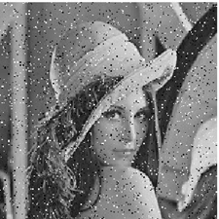






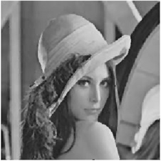
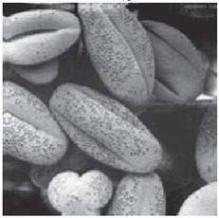
What is image filtering?
Removal of unwanted signal or undesirable characteristics from the image.
It is used to enhance or modify the image.
Input
(Noisy image)
Input
(Image with poor contrast)
Filtering operation
Filtering operation
Output
Filter Image source: https://www.star-spain.com/en/blog/transittermstar-nxt-tooltips/filtering-data-records-termstar-nxt
Output

Slide 3
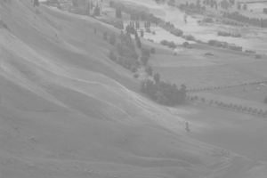
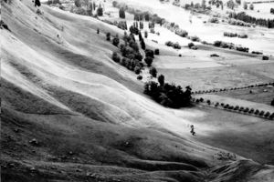
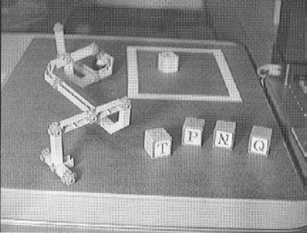
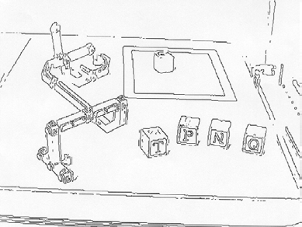
What is image filtering?
The term “filtering” basically comes from frequency domain.
Formation of a new image by applying filter on input image.
Filtering
f(x,y)
Input image
g(x,y)
Filtered image
Filtering

Slide 4
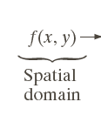


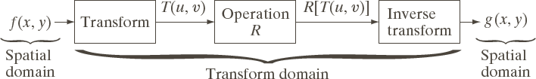
Image Filtering Methods
Spatial Domain
Frequency Domain (i.e., use of Fourier Transform)
Image source: Rafael C. Gonzalez and Richard E. Woods Digital Image Processing, 3rd edition, Pearson Education, ISBN: 978-81-317-2695-2

Slide 5
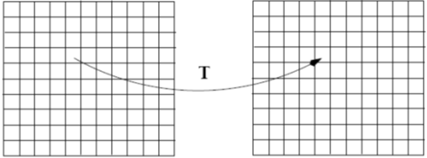
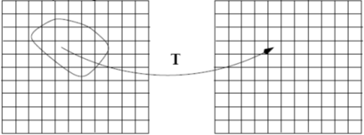

Spatial Domain Methods
Input image Enhanced output image
G(x,y)=T[f (x,y)]
^{(x}T^{,y)}operates on one pixel
f(x,y) ^{g}
Point Processing Methods
Input image Enhanced output image
f(x,y) _{g(x}
f(x,y) ^{g}
,y) G(x,y)=T[f (x,y)]
T operates on
_{(x}neighborhood of pixels
Area or Mask Processing Methods

Slide 6
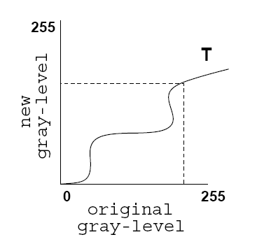
Point Processing Methods
Converting a given pixel value to a new pixel value based on some predefined function.

Slide 7
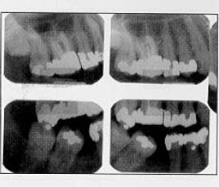
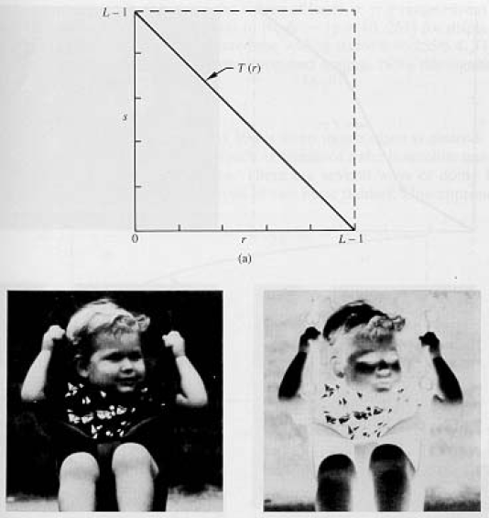
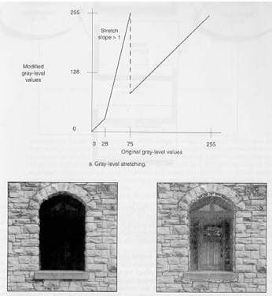
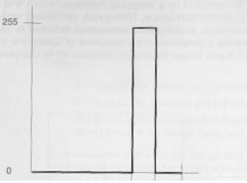
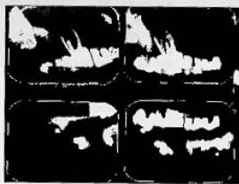
Point Processing Methods - Examples
Negative Contrast stretching
Thresholding
Input
Input
Output
Input
Output
Output
Histogram Equalization
Input
Output

Slide 8
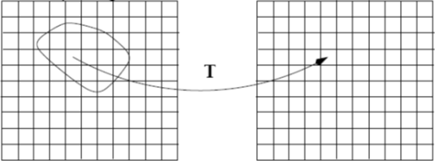
Area or Mask Processing Methods
Need to define:
Area shape and size
Operation
Input image
Enhanced image
G(x,y)=T[f (x,y)]
T operates on neighborhood of pixels
Area or Mask Processing Methods

Slide 9
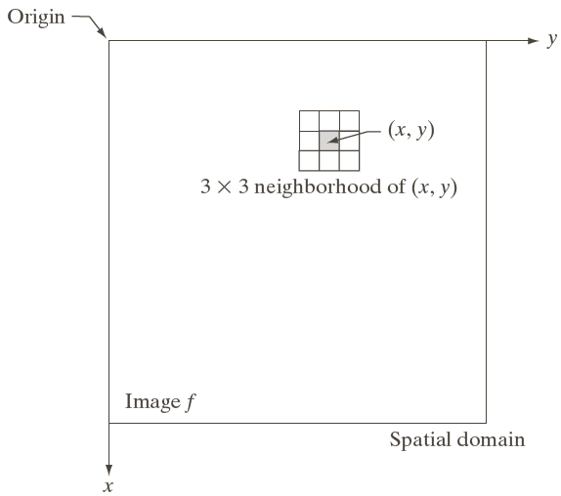
Area Shape and Size
Area shape is defined using
mask
shape
– typically defined using a square mask
Area size is determined by
mask
size, e.g., 3x3 or 5x5
Mask size is an important parameter
w₁ | w₂ | w₃
w₄ | w₅ | w₆
w₇ | w₈ | w₉
Image source: Rafael C. Gonzalez and Richard E. Woods Digital Image Processing, 3rd edition, Pearson Education, ISBN: 978-81-317-2695-2

Slide 10
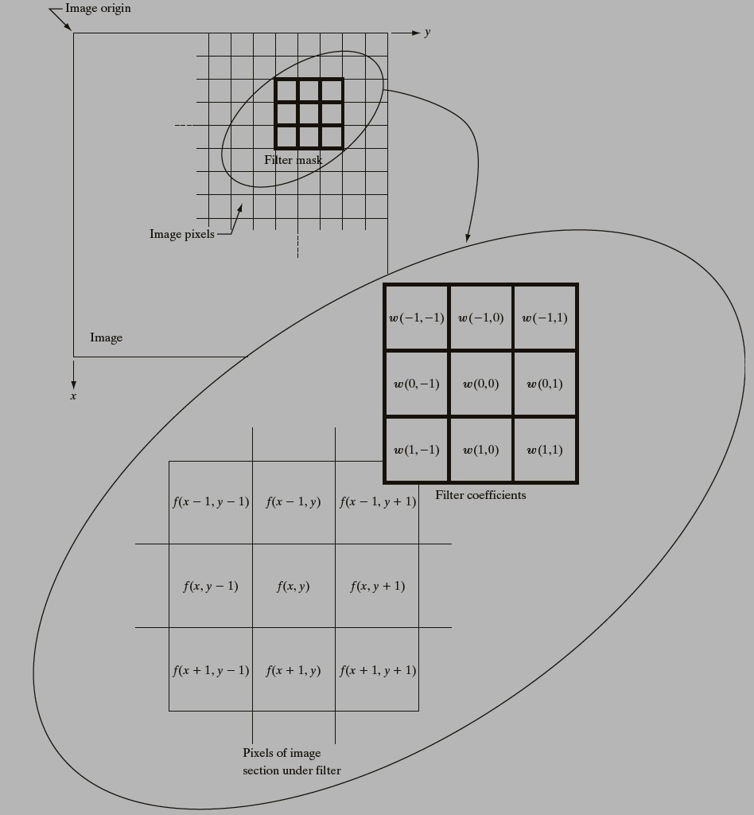
Operation
Typicallylinear combinations of pixel values.
e.g., weight pixel values and add them together.
Different results can be obtained using different weights.
e.g., smoothing, sharpening, edge detection.
Image source: Rafael C. Gonzalez and Richard E. Woods Digital Image Processing, 3rd edition, Pearson Education, ISBN: 978-81-317-2695-2

Slide 11

Example
w₁ | w₂ | w₃
w₄ | w₅ | w₆
w₇ | w₈ | w₉
🡪Weight matrix defines (is called) filter
🡪 Filter is also referred as mask, kernel
Image
10 | 5 | 3 |  | 0 | 0 | 0
4 | 6 | 1 |  | 0 | 0.5 | 0
1 | 1 | 8 |  | 0 | 1 | 0.5
 | 8
Local image neighborhood
Mask/Filter
Modified image data

Slide 12
Linear Filtering – Examples
Following uses linear filtering
Correlation
Convolution

Slide 13

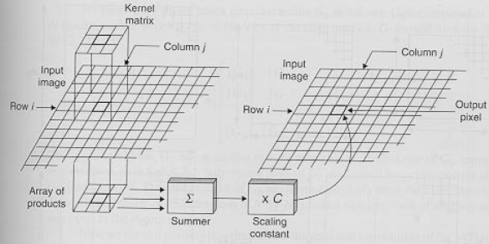
Correlation
A filtered image is generated as the center of the mask (kernel or filter) visits every pixel in the input image.
h
n × n mask
g(i,j)
f(i,j)
filtered
image

Slide 14
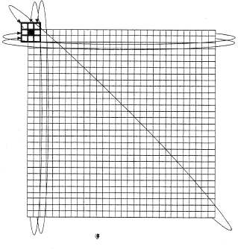
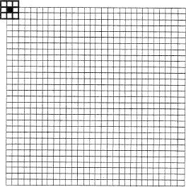
Handling Pixels Close to Boundaries
0 0 0 ……………………….0
0 0 0 ……………………….0
or
pad with zeroes
wrap around

Slide 15


















Correlation – Example
X | X | X | X | X | X
X | 10 |  |  |  | X
X |  |  |  |  | X
X |  |  |  |  | X
X |  |  |  |  | X
X | X | X | X | X | X
10 | 11 | 10 | 0 | 0 | 1
9 | 10 | 11 | 1 | 0 | 1
10 | 9 | 10 | 0 | 2 | 1
11 | 10 | 9 | 10 | 9 | 11
9 | 10 | 11 | 9 | 99 | 11
10 | 9 | 9 | 11 | 10 | 10
O
I
F
1/9
1 | 1 | 1
1 | 1 | 1
1 | 1 | 1
1/9 ×(10x1 + 11x1 + 10x1 + 9x1 + 10x1 + 11x1 + 10x1 + 9x1 + 10x1) = 1/9.( 90) = 10

Slide 16
Convolution
Same as correlation, but with kernel (filter or mask) rotated by 180⁰
Kernel, F, represents the linear weights as an image
Steps:
Rotate the kernel by 180 degrees
Center origin of the kernel F at each pixel location
Multiply weights by corresponding pixels
Set resulting value for each pixel

Slide 17
End

Slide 18
Image Filtering
Part – 2

Slide 19
Quick Review of the Last Class
Spatial Domain Filtering
Point Processing based filtering methods
Operation
Area based filtering methods
Operation
Size/Shape of the mask

Slide 20


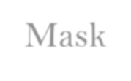
Quick Review of the Last Class
Spatial Domain Filtering
Input image
Enhanced output image
(x,y)
G(x, y)=T[f (x, y)]
T operates on one pixel
Point Processing Methods
Input image Enhanced output image
f(x,y) ^{g}
f(x,y) _{g(x}
f(x,y) ^{g}
,y)
G(x, y)=T[f (x, y)]
neighborhood of pixels
Area or Mask Processing Methods
(x,y)
T operates on

Slide 21
Quick Review of the Last Class
Spatial Filtering
Weighted Linear combinations of pixel values.
e.g., weight pixel values and add them together.
Different results can be obtained using different weights.
e.g., smoothing, sharpening, edge detection
Image source: Rafael C. Gonzalez and Richard E. Woods Digital Image Processing, 3rd edition, Pearson Education, ISBN: 978-81-317-2695-2

Slide 22
Agenda for Today’s Class
Spatial Filters
– Convolution based Filters
Order Statistics Filters
Hybrid Filters

Slide 23
Spatial Filters
Convolution based Filters
use of spatial mask, mask is convolved with the image to get desired result - Linear
– Examples:
Average or Mean Filter (Box Filter)
Gaussian Filter
Order Statistics Filters
use of spatial mask, pixel under mask are arranged in a particular order – Non-linear
Examples
Median Filter
Rank order Filters
Hybrid Filters
Combination of above two types of filters

Slide 24
Convolution based Filters
Average or Mean Filter (Box Filter)
Gaussian Filter

Slide 25

Average or Mean Filter (Box Filter)
All weights are equal
Mask with positive entries (weights) that sum to 1.
Replaces each pixel with an average of its neighborhood.
1 | 1 | 1
1 | 1 | 1
1 | 1 | 1
Average filter performs image smoothing

Slide 26
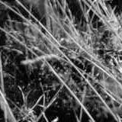
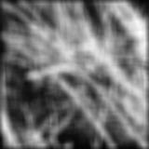
Example: Smoothing with a Box Filter

Slide 27
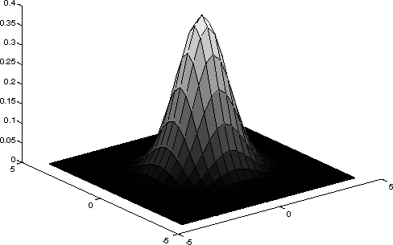
Gaussian Filter
Idea: Weight contributions of neighboring pixels by
0.003 | 0.013 | 0.022 | 0.013 | 0.003
0.013 | 0.059 | 0.097 | 0.059 | 0.013
0.022 | 0.097 | 0.159 | 0.097 | 0.022
0.013 | 0.059 | 0.097 | 0.059 | 0.013
0.003 | 0.013 | 0.022 | 0.013 | 0.003
5 x 5, σ = 1
𝟏
−
𝒆
𝒙^{𝟐}+𝒚^{𝟐}
𝑮 𝒙, 𝒚 =
𝟐𝝈^{𝟐}
Gaussian Kernel
𝝈
𝟐𝝅𝝈^{𝟐}
Constant factor at front makes volume sum to 1 (can be ignored, as we should re-normalize weights to sum to 1 in any case)

Slide 28

Smoothing with a Gaussian Filter

Slide 29
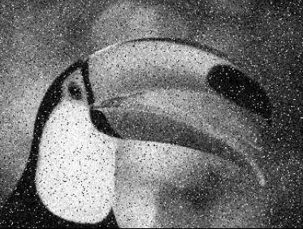
Application of Smoothing: Noise Removal
For example, the central pixel in the figure below is replaced by the value: 13
(the nearest integer
to the average)
10 | 12 | 11
11 | 23 | 12
10 | 14 | 15
How does noise get removed in smoothing?
– If any one of the pixels in the neighborhood has a faulty value due to noise, this fault will now be smeared over nine pixels as the image is smoothed
Noise is removed but smoothing tends to blur the image

Slide 30
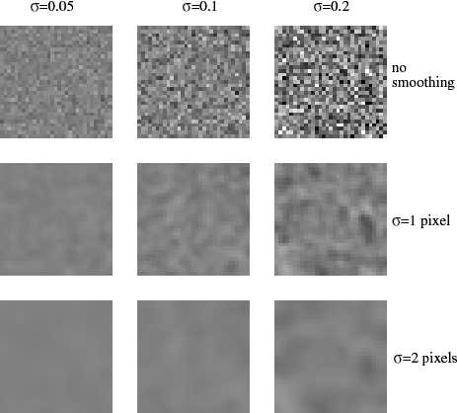
Application of Smoothing: Noise Removal
Each column shows different amounts of
Each row shows smoothing
with Gaussians of different width
Gaussian noise
Smoothing reduces pixel noise

Slide 31
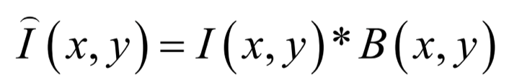
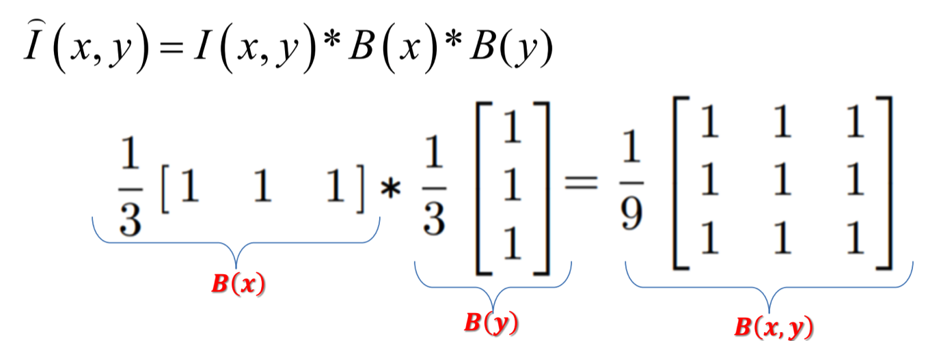
Efficient Implementation of Box and Gaussian Filters
Both the Box filter and the Gaussian filter are separable into two 1-D convolution filters:
First convolve each row with a 1-D filter
Then convolve each column with a 1-D filter
– or vice-versa

Slide 32
Separability of the Gaussian Filter
Considering 2D Gaussian equation as below
𝟏
−
𝒆
𝒙^{𝟐}+𝒚^{𝟐}
𝑮 𝒙, 𝒚 =
𝟐𝝈^{𝟐}
𝝈
𝟐𝝅𝝈^{𝟐}
Gaussian equation can be alternatively expressed as the product of two functions as shown above
_{𝒙}𝟐
_{𝒚}𝟐
One function of x
Another function of y
𝟏
𝟏
−
−
𝒆
𝑮 𝒙, 𝒚 =
𝒆
𝟐𝝈^{𝟐}
𝟐𝝈^{𝟐}
𝝈
𝟐𝝅𝝈
𝟐𝝅𝝈
These functions can be termed as 1-D Gaussian functions

Slide 33
Separability of the Gaussian Filter
I (x, y) = I (x, y)*G(x, y)
Requires n² k² multiplications for n x n image and k x k kernel.
I (x, y) = I (x, y)*G(x)*G( y)
Requires 2kn² multiplications for n by n image and k by k kernel.

Slide 34
Issues in Smoothing using Averaging
Consider a case where one of the pixels in the neighborhood has a very high faulty (spurious) value due to noise
12 | 10 | 15
10 | 33 | 11
12 | 11 | 14
This fault will now be smeared over nine pixels around it when the image is
smoothed
Since noisy value is very high, the value of all the neighboring pixel will be increased wrongly to a relatively high value

Slide 35
Order Statistics Filter
Median Filter
Rank Order Filters

Slide 36
Median Filter
A better approach for smoothing (noise removal) is to use a median filter
In median filter, similar neighborhood as in average filter is considered
But this time the pixel value is replaced by the median pixel value of the neighborhood in place of mean

Slide 37
Median Filter
How does median filtering work?
if we have a 3×3 neighborhood, we write the 9 pixel values in a sorted order, and replace the central pixel by the fifth highest value
Example:
10, 10, 11, 11, 12, 12,14, 15, 33
Here central pixel is replaced by the value 12
12 | 10 | 15
10 | 33 | 11
12 | 11 | 14

Slide 38
Median Filter
This approach has two advantages
– Occasional spurious high or low values are not averaged in,
The sharpness of edges is preserved.
To see this, consider the pixel data shown below
100 | 100 | 200 | 200
100 | 100 | 200 | 200
100 | 100 | 200 | 200

Slide 39
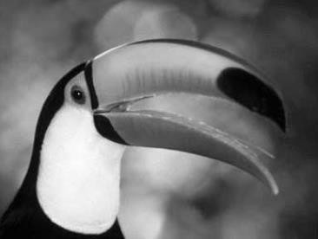
Median Filter
When the neighborhood covers the left-hand nine pixels, the median value is 100; when it covers the right hand ones, the median value is 200; thus the edge is preserved
100 | 100 | 200 | 200
100 | 100 | 200 | 200
100 | 100 | 200 | 200
Notes
– If there are large amounts of noise in an image, more than one pass of median filtering may be useful to further reduce the noise

Slide 40
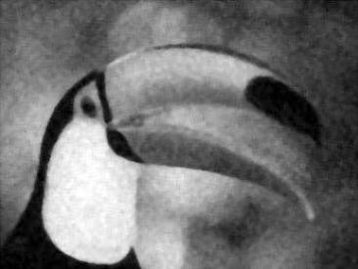
Median Filter
Original Image
Noisy Image
Median Filtered Image

Slide 41
Rank Order Filters
In place of taking the mean, rank all the pixel values in a window
–Take the n-th order value
Example: max or min or median

Slide 42
Hybrid Filters
Combination of following filters
Convolution based filter
Order statistics filter

Slide 43
End

